Slide 1
CITB NI
PRODUCTS AND SERVICES FOR THE CONSTRUCTION INDUSTRY
Press spacebar to move through each of the slide
4

Slide 2
TRAINING
MOBILE TRAINING UNIT (MTU)
Seats up to 15 people
Delivery of free short duration H&S awareness training
Select from a suite of 15 CPD accredited topics
Certificate of attendance for each attendee for your training records
Email mtubookings@citbni.org.uk to book
If you have a large number of people to be trained or have your own training facility we can arrange to have a trainer come to you.
DOWNLOAD THE BROCHURE HERE
CLICK ON VIDEO BELOW TO VIEW THE MTU

Slide 3
TRAINING
SCAFFOLDING
We offer tube and fitting, system scaffolding and advanced scaffolding at Nutts Corner Training Centre. Please check our latest flyer for details.
Click on flyer to download further information or email scaffolding@citbni.org.uk

Slide 4
BUSINESS IMPROVEMENT EVENTS
Our series of Business Improvement Events is delivered both online and at CITB NI and provides awareness training on topical issues including Digital Marketing, General ISO Awareness, Waste Management, BIM and many more. These events are free to CITB NI registered employers, and you get the opportunity to meet CITB NI representatives and hear about our products and services.
Coming up:
8 April – Carbon Management
14 May – Exploring AI in Marketing Tools for the Construction Industry
29 May – Waste Management
The full programme of events is available on the Events section of the CITB NI website or see next slide.

Slide 5
TRAINING
Heritage training Events
These training sessions are open to all wishing to learn more about working with older buildings and materials and cover topics such as Heritage Joinery, Stained Glass, Stone & Lime, Stonemasonry, Stone Carving and Retrofit.
All events are available for booking here or click on the flyer.

Slide 6
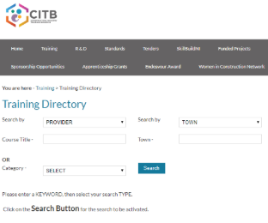
ONLINE TRAINING DIRECTORY
The CITB NI online Training Directory is available on our website. It can be used to source training available from other providers in your area and provide their contact details.
CLICK HERE TO ACCESS THE DIRECTORY ONLINE.

Slide 7
TRAINING
TRAINING IN PARTNERSHIP
CITB NI works with Industry Bodies and Federations to fund sector specific training needs
This training is usually booked through the relevant Body/Federation
The training is provided at low or no cost
Chat to your Sector Rep if you have a training need or email us traininginpartnership@citbni.org.uk

Slide 8
GRANTS 2024/25
CLICK ON FLYER BELOW TO DOWNLOAD SCHEME
£2.1M DIRECT GRANT SCHEME CURRENTLY AVAILABLE

Slide 9
GRANTS 2024/25
GRANTS ARE AVAILABLE FOR:
Employing apprentices
Qualifying and upskilling your existing workforce
Obtaining an initial Industry Registration Scheme Card
Employing an Industrial Placement Student
Travel & Accommodation for courses not available in N.I. (prior approval required)

Slide 10
GRANTS 2024/25
Grants range from £15 to £2,000 (depending on the grant category)
Terms and Conditions of the scheme can be downloaded here
Terms and conditions must be met before grants will be processed

Slide 11
GRANTS 2024/25
Apply within 3 months of commencement of training or upon registration onto course or apprenticeship scheme.
Apply for a grant online here you will need your log in details
Supporting information for short duration off the job, in house training & training providers must be received within 3 months of training taking place.
Your CITB NI Annual Return Form including options forms must have been received prior to the deadline. Please contact the levy support team if you have any queries levy@citbni.org.uk

Slide 12
GRANTS 2024/25
Levy payers can claim grant up to 100% of the total of levy paid
Non levy payers can claim grant up to £500 in the training year
The above limits only apply to short duration training courses lasting up to 10 days

Slide 13
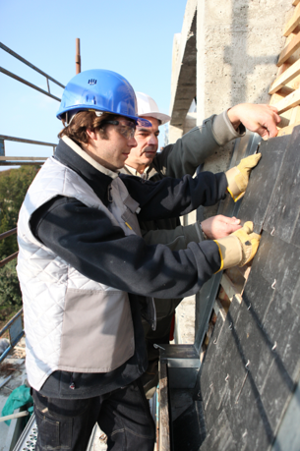
APPRENTICE GRANT
THINKING OF EMPLOYING AN APPRENTICE?
The CITB NI enhanced apprentice grant of up to £6,500 is paid to employers who employ an apprentice on a formal apprenticeship training programme and is paid as illustrated on the following slides.

Slide 14
APPRENTICE GRANT – Level 2/3
YEAR 1 | EMPLOYMENT GRANT | £1,500 | RUNNING TOTAL
YEAR 2 | EMPLOYMENT GRANT | £1,500 | £3,000
 | VQ LEVEL 2 ACHIEVEMENT GRANT | £1,000 | £4,000
YEAR 3 | EMPLOYMENT GRANT | £1,000 | £5,000
 | VQ LEVEL 3 ACHIEVEMENT GRANT | £1,500 | £6,500

Slide 15
APPRENTICE GRANT INFORMATION
The £6,500 grant is available for all apprenticeships including business support staff and on achievement of relevant qualifications.
Apprentices must be registered onto an Apprenticeship NI Programme and employed.
The apprentice must be employed by the employer claiming the grant for a minimum of 6 months.
THERE IS NO CAP ON APPRENTICE GRANTS

Slide 16
APPRENTICE GRANT INFORMATION
Additional Support:
DfE Employer Incentive Grant of £1,674 on achievement of NVQ Level 2 (£837) and Level 3 (£837) – paid through the training provider.

Slide 17
APPRENTICE GRANT INFORMATION
Total potential apprentice grant available:
CITB NI £6,500
DfE Incentive Grant £1,674
TOTAL GRANT £8,174

Slide 18
HIGHER LEVEL APPRENTICE GRANT
Do you employ a higher level apprentice who is undertaking or are about to undertake a higher level qualification?
If so, submit your application for the CITB NI Higher Level Apprentice Grant here

Slide 19
HIGHER LEVEL APPRENTICE GRANT
Your apprentice should already have completed ‘A’ levels or equivalent
Qualifications available from Level 4 to Level 7
Apprentice must be employed
Length of course will vary but will be a minimum of two years
Grant will be paid as shown in the next slide
The apprentice must be employed by the employer claiming the grant for a minimum of 6 months.

Slide 20
HIGHER LEVEL APPRENTICE GRANT
UP TO LEVEL 5
First Year Employment Grant £1,500
Second Year Employment Grant £1,500
Third Year Employment Grant £1,500
£2,000 payable on achievement of full HLA
LEVEL 6 & ABOVE
Grant will be paid at £2,000 on achievement. Grant claim must be submitted within 3 months of notification of successful completion.

Slide 21
HLA APPRENTICE GRANT INFO
The HLA grant is available for all apprenticeships including business support staff and on achievement of relevant qualifications.
Apprentices must be registered onto a Higher Level Apprenticeship Programme and employed.
THERE IS NO CAP ON APPRENTICE GRANTS

Slide 22
HELP FOR EMPLOYERS
CITB NI has produced a Guide for Employers who are considering or are wanting to employ an apprentice.
Click on the flyer to download

Slide 23
HELP FOR EMPLOYERS
10 reasons why you should employ an Apprentice
Click on the flyer to download

Slide 24
LEVY
Every construction employer must complete and return their annual Statutory Return Form to CITB NI before the deadline.
By doing this you are able to obtain all the products and services we offer.
The levy rate is 0.55% and the threshold is £80,000 for 2024/25.

Slide 25
RESEARCH ACTIVITY
CITB NI undertakes a number of research activities throughout the year.
Our research informs the industry of the outlook for construction and where the skills requirements will be and the annual recruitment requirements.
All of our research is published on our website and can be found here.

Slide 26
CITB NI PUBLICATIONS
Our free A5 Pocket sized Health & Safety Advisory Booklets are available to download from our website here or you can collect from CITB NI for your workforce.
They are available for 14 different occupations.

Slide 27
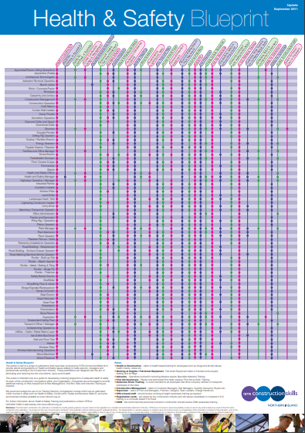
CITB NI PUBLICATIONS
Download the CITB NI Health & Safety Blueprint.
This is a list of construction occupations and the recommended Health & Safety Training to be carried out.
Click here to download.

Slide 28
CITB NI ADOPT A SCHOOL SCHEME
Encourage more young people to consider a career in construction!
CITB NI is looking for construction companies to participate in the free ‘Adopt A School’ scheme.
Click on the flyer to find out how your company can get involved.

Slide 29
CONTACT US
Grants grants@citbni.org.uk
Levy levy@citbni.org.uk
General info@citbni.org.uk
CITB NI
17 Dundrod Road
Crumlin
Co Antrim
BT29 4SR
Tel: 028 9082 5466
www.citbni.org.uk

